Slide 1

High Level
Programming Department
2nd Session :
HTML & CSS

Slide 2

1. Introduction to HTML
2. Introduction to CSS
3. HTML tricks
4. CSS tricks

Slide 3
Introduction to HTML

Slide 4

HTML : HyperText Markup Language
"Hypertext" refers to links that connect web pages to one another, either within a single website or between websites.
Links are a fundamental aspect of the Web.
Introduction to
HTML

Slide 5
HTML uses "Markup" to annotate text, images, and other content for display in a Web browser. HTML markup includes special "elements" such as <head>, <title>, <body>, <p>, <div>, <span>, <img>, <video>, <ul>, <ol>, <li> and many others..
Introduction to
HTML

Slide 6
Introduction to
HTML
HTML is the code that you use to structure your web content and give it meaning and purpose.

Slide 7
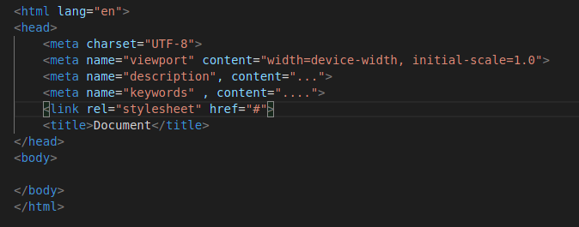
<Head>
Introduction to
HTML

Slide 8
Introduction to CSS

Slide 9
Introduction to
CSS
CSS (Cascading Style Sheets) is a language for specifying how documents are presented to users, how they are styled, laid out, etc.

Slide 10
How does CSS actually work?
When a browser displays a document, it must combine the document's content with its style information. It processes the document in a number of stages;
Introduction to
CSS

Slide 11
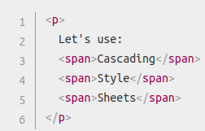
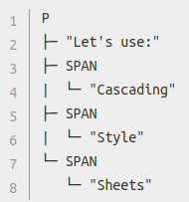
1. The browser loads the HTML
2. It converts the HTML into a DOM (Document Object Model). The DOM represents the document in the computer's memory.
CODE: DOM :
Introduction to
CSS

Slide 12
3. The browser then fetches most of the resources that are linked to by the HTML document, such as embedded images and videos ... and linked CSS
4. The browser parses the fetched CSS, and sorts the different rules by their selector types into different element, class, ID, ... . Based on the selectors it finds, it works out which rules should be applied to which nodes in the DOM, and attaches style to them as required (this intermediate step is called a render tree) .
Introduction to
CSS

Slide 13
HTML
Tricks

Slide 14
1. The <progress> tag
2. Input suggestions
3. The <map> tag
HTML
Tricks

Slide 15
CSS
Tricks

Slide 16
CSS
Tricks
1. Box shadow
2. Parallax Effect

Slide 17
Thanks For Attending

